Slide 1
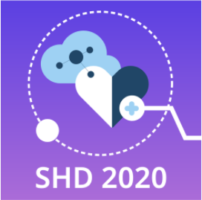
Alzheimer's MRI Image Analysis
Synthetic Health Data Hackathon 2020
Team Aryubia

Slide 2
01
PRESENTATION CONTENTS
02
03
Exploratory Data Analysis
Building the DL model
Evaluation & Conclusion

Slide 3
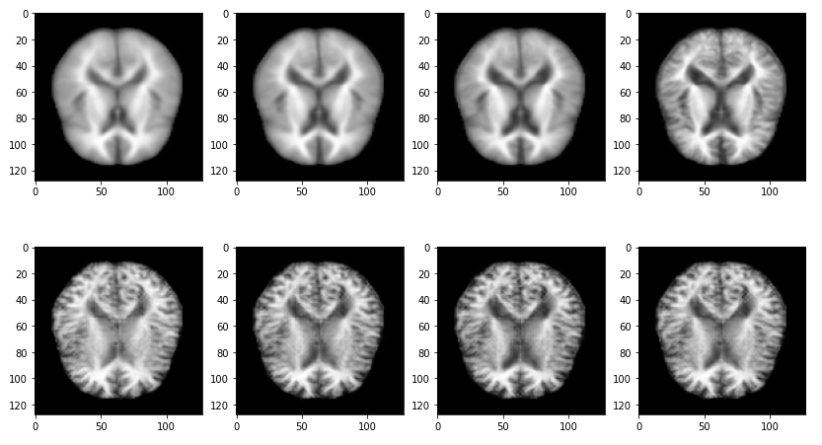
Exploratory Data Analysis (1)
Non
Very Mild
Mild
Moderate
Real
Synthetic

Slide 4
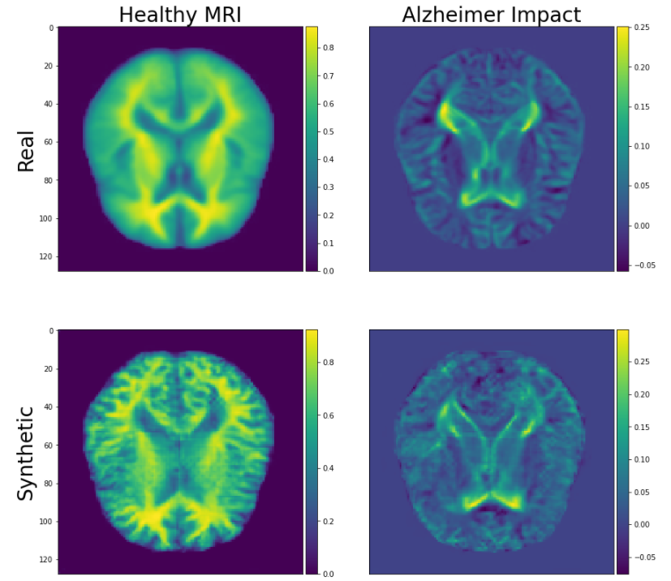
Exploratory Data Analysis (2)

Slide 5
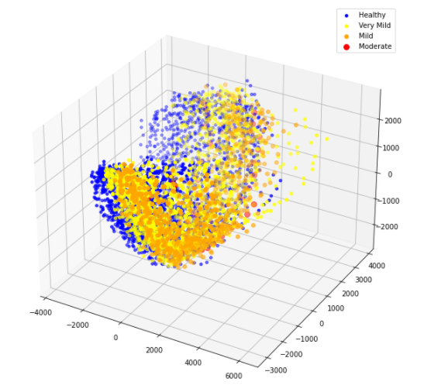
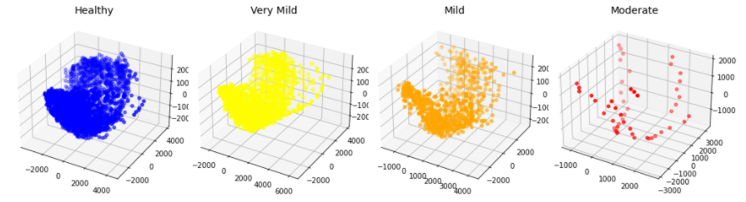
Real Data Distribution

Slide 6
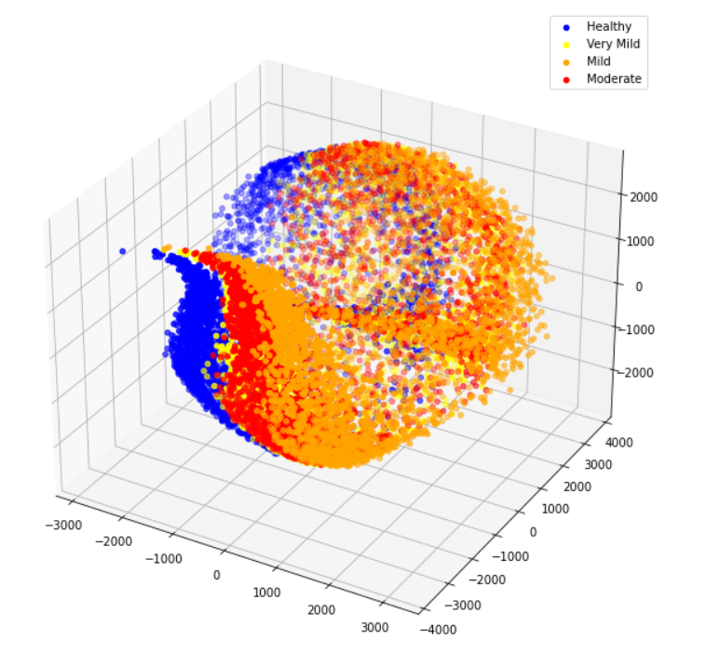
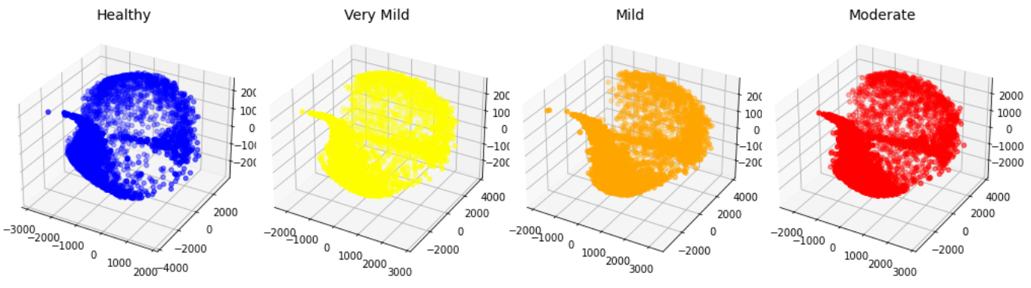
Synthetic Data Distribution

Slide 7
Real vs Synthetic Data

Slide 8
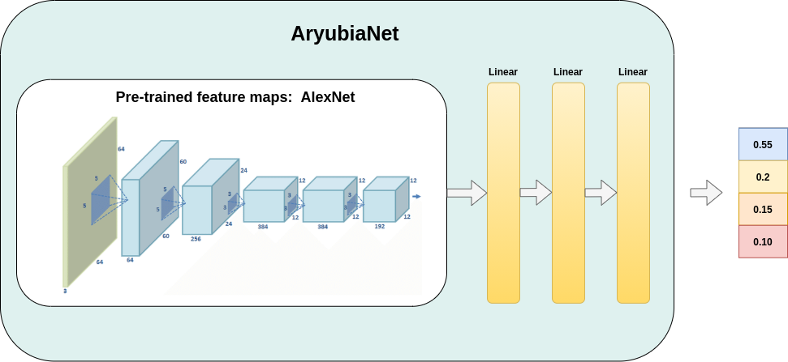
Making of AryubiaNet
Notes:
Dropout batchnorm and relu act functions

Slide 9
Training Objectives & Evaluation
Training Set 1: Real MRI Dataset
57.76% accuracy
Training Set 2: Real+Synthetic MRI Dataset
65.54% accuracy
Test Set: Real MRI Dataset V.2
Non - 640, Very Mild - 448, Mild - 179, Moderate - 12
Notes:
Our main obj is to check if the synthetic data can be helpful in the class of the AD patients
In the first model which was trained with real … And in the 2nd with the comb of real and synthetic dataset

Slide 10
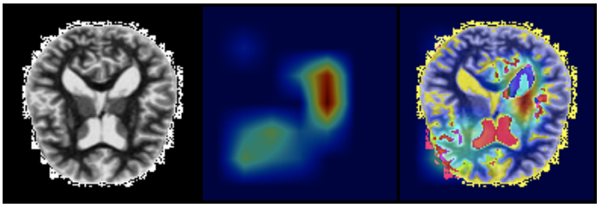
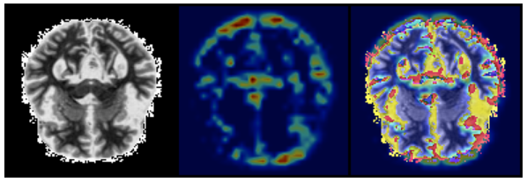
Grad-Cam and AryubiaNet
Healthy case
Moderate case

Slide 11
Conclusions
Medical domain
AI can be a helping hand in assisting medical experts by providing ways for deeper analysis and finding accurate patterns in health data
Industrial Research
Synthetic data can enhance and accelerate the Research to Production pipeline
They can fill in gaps in cases where enough data are not available
Ethics
Anonymity provided by Synthetic data can bypass sensitive social issues

Slide 12


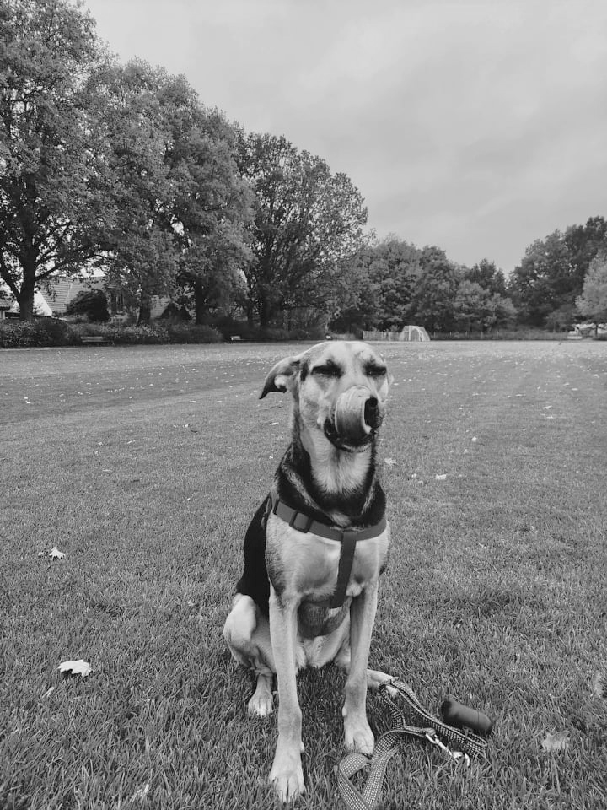
ARYUBIA team
Electra Zarafeta
AI MSc Student
Mihalis Gongolidis
ML NLP Researcher
Arya
Break Scheduler

Slide 13
THANK YOU FOR
YOUR ATTENTION!
Do you have any questions?

